Slide 1
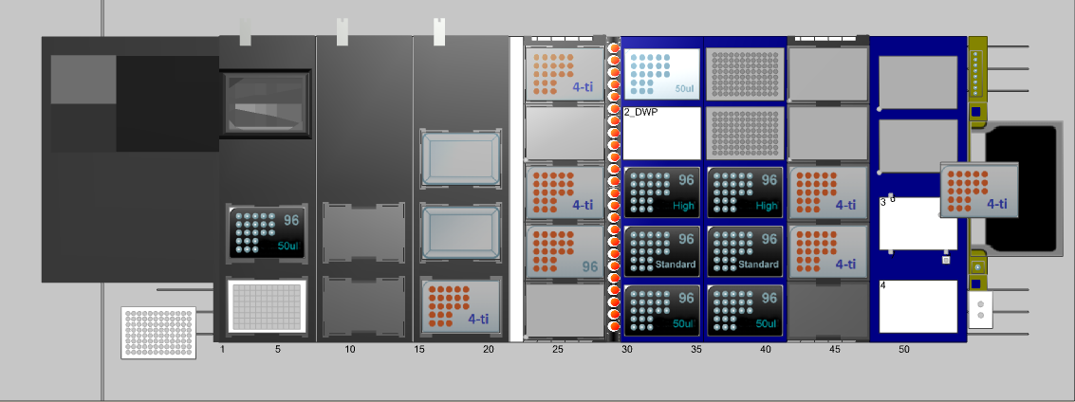
Abgene plate w/lid
2 racks of 1000 uL filter tips
Media trough w/lid: 250 mL media
3 mL bacterial stock

Slide 2
Remove glycerol stock plates from deck, seal, and store at -80 C

Slide 3
Glycerol stock plate w/lid:
Eppendorf 500 uL DNA lo-bind receiving plate
37.5 uL media + 112.5 uL 40% glycerol/well

